Slide 1
Machine Learning
BCSML601
3:0:2

Slide 2
Pre- requisites
Linear Equations
Probability and Statistics
Graphs of Functions

Slide 3
Course Learning Objectives (CLO)
This course will enable students to,
Define machine learning and understand the basic theory underlying machine learning.
Differentiate supervised, unsupervised and reinforcement learning
Understand the basic concepts of learning and decision trees.
Understand neural networks and Bayesian techniques for problems appear in machine learning
Understand the instant based learning and statistical analysis of machine learning techniques.

Slide 4
MODULE 5
Instance Based Learning
Introduction
k-nearest neighbor learning
locally weighted regression
Radial Basis Functions
Case-based reasoning
Reinforcement Learning:
Introduction,
The learning task,
Q-Learning

Slide 5
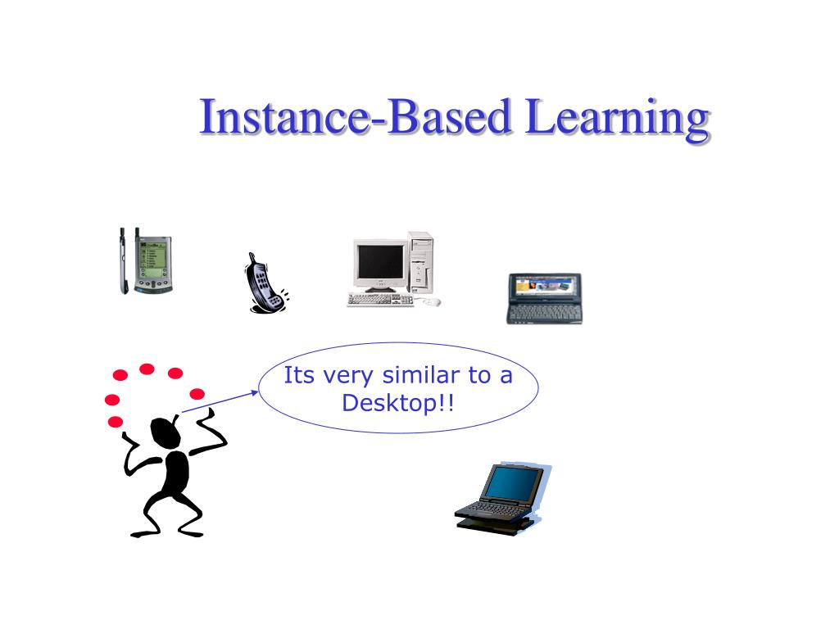
Instance Based Learning - Introduction

Slide 6
Instance Based Learning - Introduction
Instance-based learning, also known as memory-based or lazy learning, is a family of machine learning algorithms that rely on storing and using training instances to make predictions for new instances.
Instance-based learning involves using the entire dataset to make predictions.
The machine learns by storing all instances of data and then using these instances to make predictions on new data.
The machine compares the new data to the instances it has seen before and uses the closest match to make a prediction.
Instance-based learning is often used in pattern recognition, clustering, and anomaly detection.

Slide 7
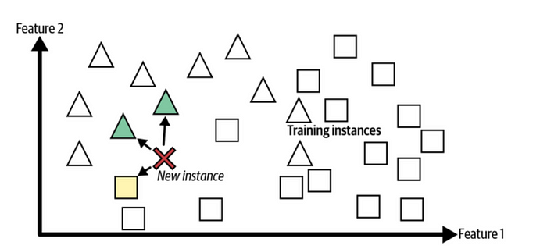
‘X’ is a new instance
‘X’ having three nearest neighbors k=3, of which majority 2 are triangles, and hence, X is put into triangle category

Slide 8
Advantages
Disadvantages
No need for model creation: doesn’t require creating a model
Can handle small datasets: because it doesn’t require a large dataset to create a model.
More flexibility: because the machine stores all instances of data and can use this data to make predictions.
Slower predictions: because the machine has to compare the new data to all instances of data in order to make a prediction.
Less accurate predictions: because it doesn’t have a mathematical model to generalize from.
Limited understanding of data: doesn’t provide as much insight into the relationships between input and output variables as model-based learning does.

Slide 9
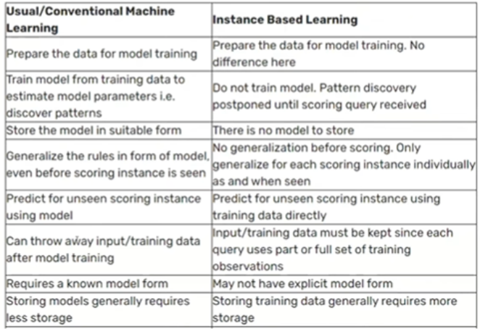

Slide 10
k-Nearest Neighbor Learning
The K-Nearest Neighbors (KNN) algorithm is a supervised machine learning method used for both classification and regression tasks.
For classification problems, the KNN algorithm assigns the test data point to the class that appears most frequently among the k-nearest neighbors, i.e., the class with the highest number of neighbors is the predicted class.
For regression problems, the KNN algorithm assigns the test data point the average of the k-nearest neighbors' values.
The following two properties would define KNN well −
Lazy learning algorithm − because it does not have a specialized training phase and uses all the data for training while classification.
Non-parametric learning algorithm −because it doesn't assume anything about the underlying data.

Slide 11
KNN operates on the principle of similarity, predicting the label or value of a new data point by considering the labels or values of its K nearest neighbors in the training dataset.
Here are the steps involved:
Selecting the Optimal Value of K: K represents the number of nearest neighbors to consider while making a prediction.
Calculating Distance: The distance between the target and training data points is measured using metrics like Euclidean distance.
Finding Nearest Neighbors: The K data points with the smallest distances to the target point are identified.
Voting for Classification or Taking Average for Regression: For classification, the class labels of K-nearest neighbors are determined by majority voting. For regression, the average of the target values of K nearest neighbors is taken

Slide 12
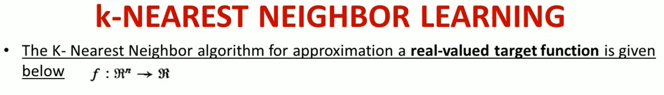
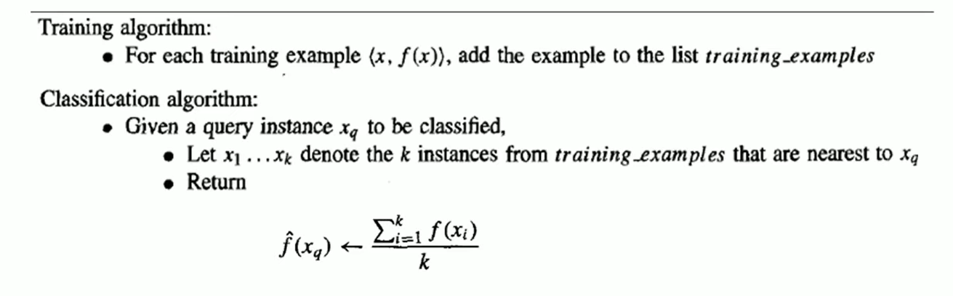

Slide 13
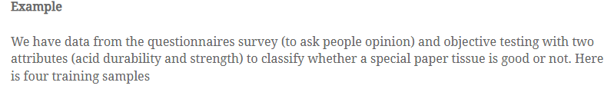
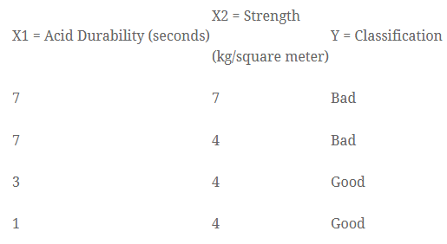

Slide 14
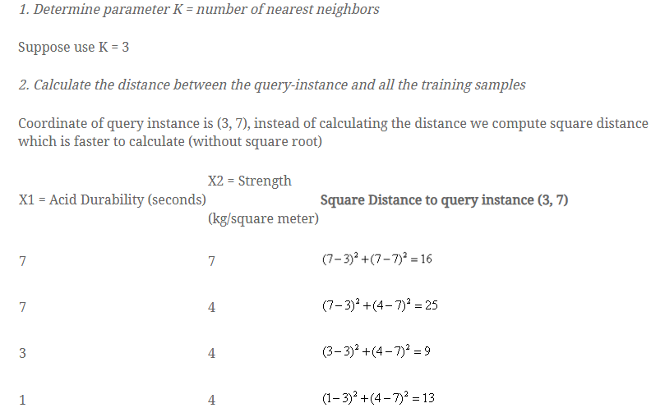
Rank Category
3 Bad
4 ------
\
1 Good
2 Good

Slide 15
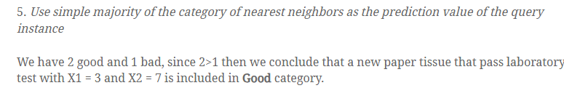

Slide 16
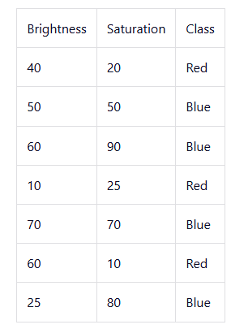
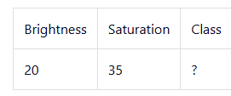
assume the value of K is 5
To know its class, calculate the distance from the new entry to other entries in the data set using the Euclidean distance formula.
√(X₂-X₁)²+(Y₂-Y₁)²
X₂ = New entry's brightness (20).
X₁= Existing entry's brightness.
Y₂ = New entry's saturation (35).
Y₁ = Existing entry's saturation.

Slide 17
d1 = √(20 - 40)² + (35 - 20)² = √400 + 225 = √625 = 25
d2 = √(20 - 50)² + (35 - 50)² = √900 + 225 = √1125 = 33.54
d3 = √(20 - 60)² + (35 - 90)² = √1600 + 3025 = √4625 = 68.01

Slide 18
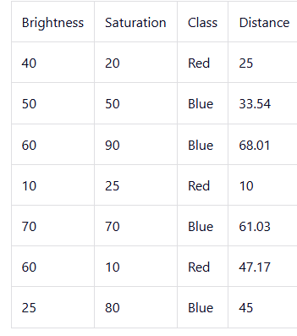
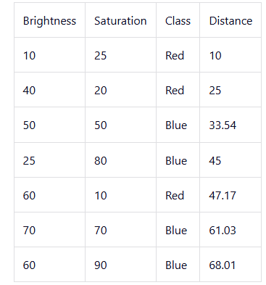
Arranged in ascending order

Slide 19
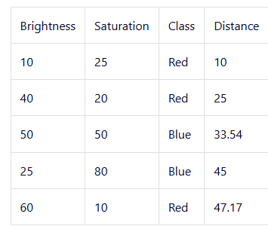
Since we chose 5 as the value of K, we'll only consider the first five rows.
The majority class within the 5 nearest neighbors to the new entry is Red.
Therefore, classify the new entry as Red

Slide 20
Distance-Weighted NEAREST NEIGHBOR Algorithm
Refinement to the k-Nearest Neighbor algorithm is to weight the contribution of each of the k neighbors according to their distance to the query point x_{q} giving greater weight to closer neighbors.
Weights are usually assigned by computing the inverse of each distance, adding the inverses of each distance and dividing each inverse by the sum
Example: consider samples of 3 classes A, B, C
If distances computed are (1, 3, 4, 5, 2)
then inverses are (1/1, 1/3, 1/4, 1/5, 1/2),
Sum = (1/1 + 1/3+ 1/4 + 1/5 + 1/2) = 2.28,
Divide each inverse by sum = (1/2.28, 2.28/3, 2.28/4, 2.28/5, 2.28/2)
= (0.44-A, 0.76-B, 0.57-A, 0.456-A, 1.14-C) a new sample belongs to class A

Slide 21
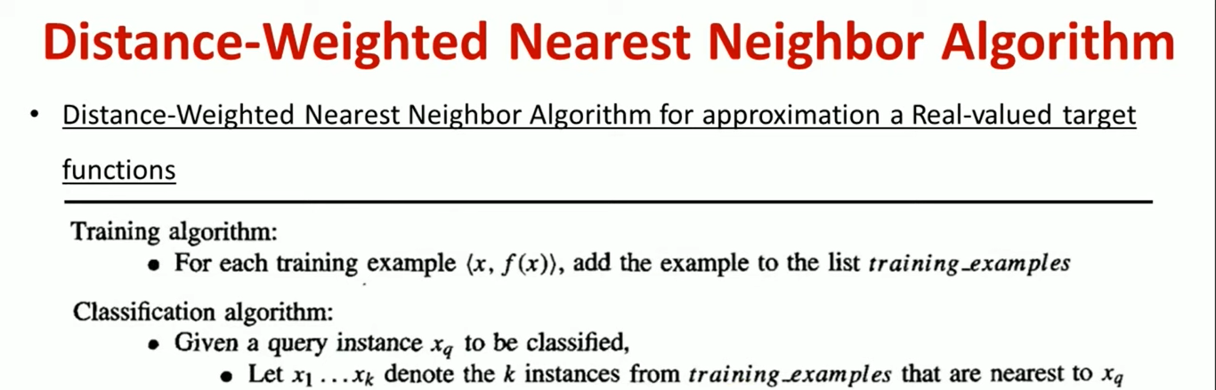
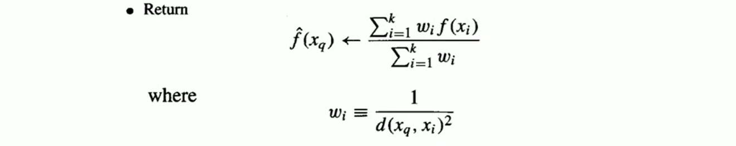

Slide 22
LOCALLY WEIGHTED REGRESSION
Locally Weighted Regression (LWR) is a non-parametric algorithm used in machine learning for regression analysis.
Unlike traditional linear regression, which assumes a global linear relationship between the input and output variables, LWR focuses on local patterns and relationships within the data.
This makes it particularly useful for datasets with non-linear relationships.

Slide 23
LOCALLY WEIGHTED LINEAR REGRESSION
Locally weighted linear regression is the nonparametric regression methods that combine k-nearest neighbor based machine learning.
It is referred to as locally weighted because, for a query point, the function is approximated on the basis of data near that and weighted because the contribution is weighted by its distance from the query point.
Locally Weighted Regression (LWR) is a non-parametric, memory-based algorithm, which means it explicitly retains training data and used it for every time a prediction is made.
There exists No training phase. All the work is done during the testing phase/while making predictions.
The dataset must always be available for predictions.
This algorithm is used for making predictions when there exists a non-linear relationship between the features.

Slide 24
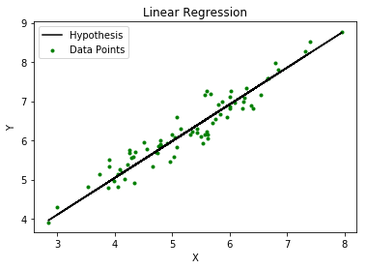
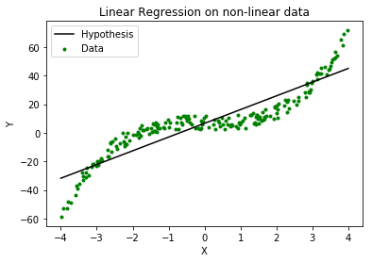
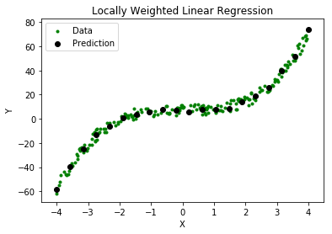

Slide 25
LOCALLY WEIGHTED LINEAR REGRESSION
Consider the case of locally weighted regression in which the target function f is approximated near x, using a linear function of the form
Where a_{i}(x) denotes the value of the ith attribute of the instance x
Methods to choose weights that minimize the squared error summed over the set D of training examples
Which led to gradient descent training rule
But, it’s a global error, and so, modify this procedure to derive a local approximation error E to emphasize fitting the local training examples.

Slide 26
Three possible criteria are given below: the error E(x_{q}) is to emphasize the fact that now the error is being defined as a cost function of the query point x_{q}

Slide 27
Applications
Time Series Analysis: LWLR can capture the dynamics of time-varying data by adapting to local patterns and trends, making accurate predictions over time.
Anomaly Detection: LWLR helps detect abnormal behavior in domains like fraud detection or network intrusion detection by identifying deviations from expected patterns in a localized manner.
Robotics and Control Systems: LWLR enables precise control and decision-making in dynamic environments by modeling and predicting the behavior of complex systems.
Benefits
Improved Predictive Accuracy: By considering local patterns, LWLR captures subtle nuances in the data, resulting in more accurate predictions
Flexibility and Adaptability: LWLR can adapt to different regions of the dataset, making it suitable for complex and non-linear relationships.
Interpretable Results: Despite its adaptive nature, LWLR provides interpretable results, offering insights into the relationships between variables within specific regions of the data

Slide 28
RADIAL BASIS FUNCTIONS
A Radial Basis Function (RBF) is a type of mathematical function whose value depends only on the distance from a central point.
RBFs are commonly used to model non-linear relationships, making them effective for tasks like function approximation, classification, and regression.
One approach to function approximation that is closely related to distance-weighted regression and also to artificial neural networks is learning with radial basis functions

Slide 29
Assume we have a classification problem to predict whether a student will pass or fail the examination.
The following features are independent variables:
Marks in internal exams
Marks in projects
Attendance percentage
So, these 3 independent variables become 3 dimensions of a space

Slide 30
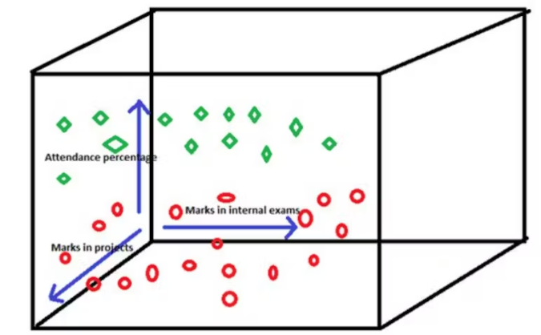
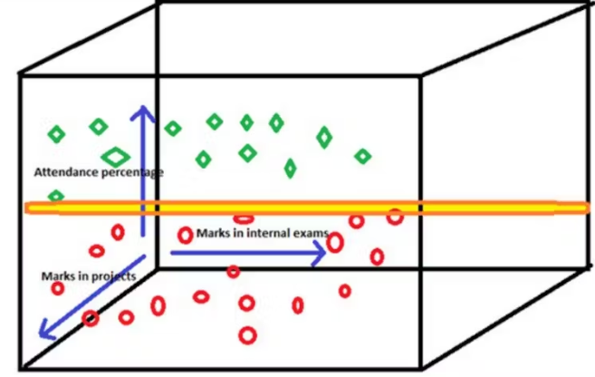
consider that our data points look like this where-
The green colour represents the students who passed the examination
The red colour represents the students who failed the examination
SVM will create a hyperplane that travels through these 3 dimensions in order to differentiate the failed and passed students

Slide 31
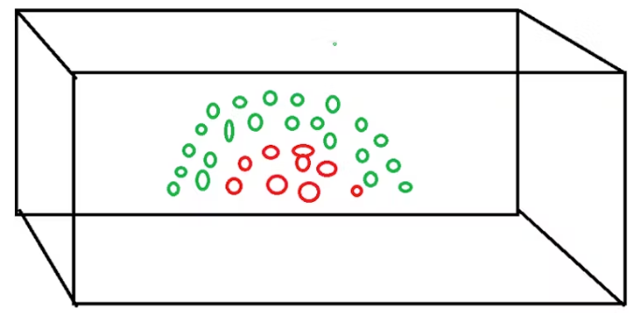
Consider that the data points are looking like this in the space
We cannot use a linear hyperplane such that it can group the data points according to their classes

Slide 32
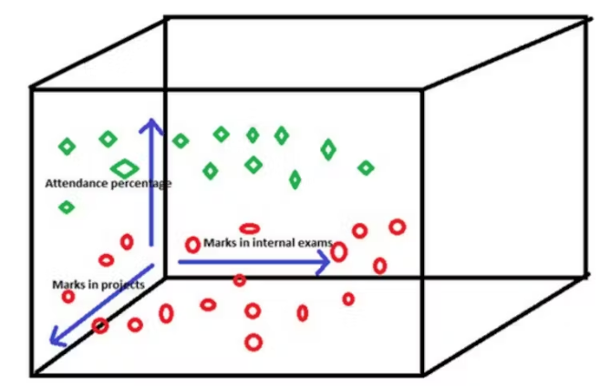
Solution- RBF - Expansion of data points
There are 2 different processes that are done by these functions-
Expanding the data points across the horizontal direction
Compressing the data points across the vertical direction
After the expansion and compression, the data points would have been transformed like this

Slide 33
RBF is also used along with artificial neural networks with one hidden layer.
In such types of networks, RBF will be used as activation functions in the hidden layers.
Apart from the hidden layer, there will be an input layer that contains several neurons where each one of them represents a feature variable and the output layer will be having a weighted sum of outputs from the hidden layer to form the network outputs.
Each hidden unit produces an activation determined by a Gaussian function centered at some instance x_{u}.
Therefore, its activation will be close to zero unless the input x is near x_{u}.
The output unit produces a linear combination of the hidden unit activations.
Multiple output units can also be included.

Slide 34
Reinforcement Learning
Reinforcement learning addresses the question of how an autonomous agent that senses and acts in its environment can learn to choose optimal actions to achieve its goals.
For example, when training an agent to play a game the trainer might provide a positive reward when the game is won, negative reward when it is lost, and zero reward in all other states.
The task of the agent is to learn from this indirect, delayed reward, to choose sequences of actions that produce the greatest cumulative reward.
In general, an agent must learn to choose actions that alter the state of its environment and where a cumulative reward function is used to define the quality of any given action sequence.

Slide 35
An agent interacting with its environment.
The agent exists in an environment described by some set of possible states S.
It can perform any of a set of possible actions A.
Each time it performs an action a, in some state st the agent receives a real-valued reward r, that indicates the immediate value of this state-action transition.
This produces a sequence of states si, actions ai, and immediate rewards ri as shown in the figure.
The agent's task is to learn a control policy, π : S + A, that maximizes the expected sum of these rewards, with future rewards discounted exponentially by their delay.

Slide 36
Q learning
Q-learning is a model-free reinforcement learning algorithm used to train agents (computer programs) to make optimal decisions by interacting with an environment.
It helps the agent explore different actions and learn which ones lead to better outcomes.
The agent uses trial and error to determine which actions result in rewards (good outcomes) or penalties (bad outcomes).

Slide 37
Q Learning Algorithm
Where:
Q(s, a) is the Q-value for a given state-action pair.
r is the immediate reward for taking action a in state s.
γ is the discount factor, representing the importance of future rewards.
maxa​Q(s’,a) is the maximum Q-value for the next state s’ and all possible actions.

Slide 38
Thank You

